Slide 1
PRESENTATION TO THE ONTARIO HOP GROWERS’ ASSOCIATION (OGHA) AGM
Durham College
FEBRUARY 22, 2020

Slide 2
ABOUT ONTARIO’S CRAFT BREWERIES
Ontario’s craft breweries are located in over 110 communities across the province, with a heavy concentration in rural and northern Ontario
Today there are 280 brick and mortar breweries, 69 contract brewers, 55 brew pubs, and 17 others with pending brewery applications
Brewers have deep ties to the local community and are often among the largest employers
OCB’S VISION
To be a catalyst for growth in Ontario’s craft beer industry by creating an environment of inclusiveness, collaboration, innovation, and advocacy for all stakeholders.

Slide 3
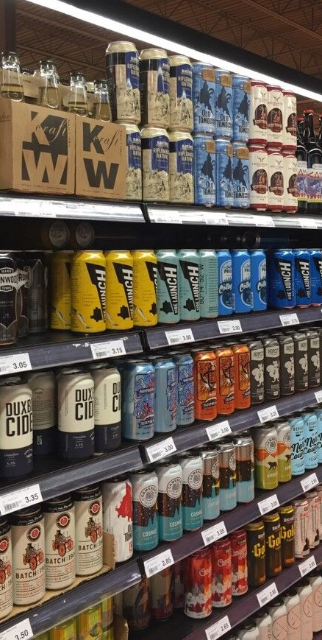
Craft Beer by the Numbers
Ontario’s craft beer industry has experienced tremendous, but fragile growth over the past decade. As of 2019,
$2 billion in annual economic impact
Over $400 million in sales (11% of beer volume sold)
$60 million in capital investment annually
Over 4,000 FTE jobs, representing 80% of all direct brewery jobs
Over 9,000 jobs supported in tourism, agriculture, manufacturing, and other industries

Slide 4
CHANNEL VOLUME/SHARE - 2019
Channel | Volume | Share
LCBO | 215,382 | 11.7%
TBS | 71,013 | 1.9%
Grocery | 74,103 | 15%
Craft Brewer Direct | 200,100 | --
Licensee | 230,701 | 16%
Total Market | 791,299 | 10.3%

Slide 5
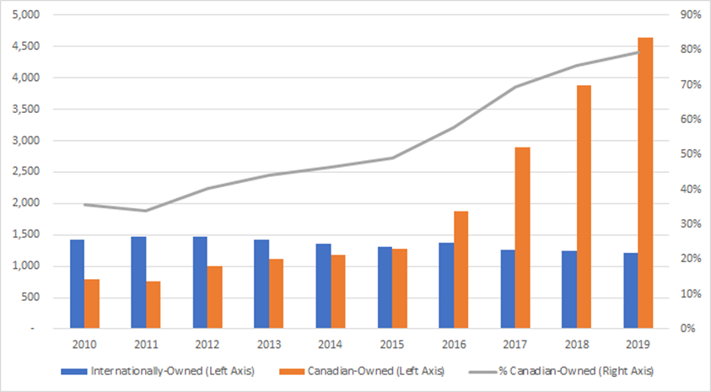
Job Growth
2010-2019

Slide 6
NEW MEMBERS
The OCB continues to see strong membership growth. Here is a list of members who have joined over the past year:
Northern Maverick Brewing Co
Bench Brewing Co.
Fenelon Falls Brewing Co
Fixed Gear Brewery
Exchange Brewery, The
Kingsville Brewing Co
Northern Superior Brewing Co.
Muddy York Brewing Co
Equals Brewing Company Inc
Stonehooker Brewing Co
Paniza Brewing Co Inc
Gateway City Brewery
Signal Brewing Company
Napanee Brewing Company

Slide 7
ADVOCACY SUCCESSES
Recent policy changes as a result of our advocacy:
Eliminating mandated serving sizes in tap rooms
Extending hours of sale from 9:00am to midnight to increase profitability
Halting the planned 3 cent a litre tax increases which saved breweries thousands of dollars

Slide 8
ADVOCACY SUCCESSES CONT’D
Recent policy changes as a result of our advocacy:
Giving Municipalities Flexibility to Make Own Rules around Consumption i.e. local parks etc.
Allowing dogs on brewery patios and taprooms
Removing Interprovincial Personal Exemption Limits on Beverage Alcohol

Slide 9
CURRENT ADVOCACY
After extensive consultations with our members, OCB has been advocating for these retail changes to be included in the government’s reforms to the beverage alcohol system:
Ensure all new retail locations come with assurances of no listing fees or inducements
Commit a minimum of 30% shelf space to be mandated and reserved for craft brewers in all retail channels
Allow existing craft breweries to be able to open additional retail locations without the caveat of having to be accompanied by an operating brewery
Ensure a minimum craft beer wholesale price for all retail channels
Allow craft brewers to open/operate pop-up locations, such as at farmers markets, parks, and community events

Slide 10
Ontario’s Hop Industry Identifying the Opportunities

Slide 11
ONTARIO’S HOP INDUSTRY
Success for craft brewers = success for hop growers’
Bedrock of this success is the strong partnerships between local brewers and hop growers’ in communities across Ontario that have developed over past decade.
OCB & OGHA looking for opportunities to promote and grow our sectors.
OCB funded hop farming soil conditions study at Trent University and is also involved with the “terroir” sensory project.
Craft brewers have a commitment to use local ingredients wherever possible – seeing beers with 70% and even 100% local hops.
A top priority for OCB is access to sell our products in local farmers’ markets – a commitment to local products – such as OGHA hops – key part of making that happen.
We want to continue to work closely with your sector to create jobs, invest, and grow.

Slide 12
QUESTIONS?

Slide 13
THANK YOU FOR YOUR SUPPORT!

