Slide 1
2019 Growing Season Report
Presented February 22, 2020
Prepared by: Canadian Food and Wine Institute Innovation Centre

Slide 2
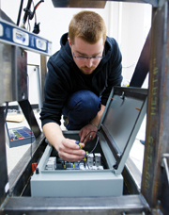
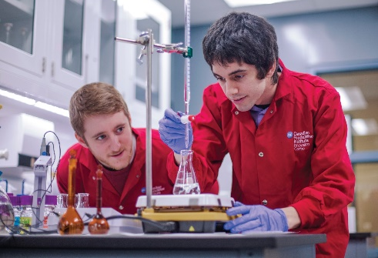
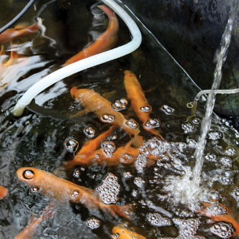
Niagara College, Research & Innovation
SUPPORTING INNOVATION
in Business & Key Industry Sectors
Notes:
We exist to support industry, including hop growers and craft brewers.

Slide 3
History
2015: CFWI IC & OHGA hops analysis research project
2016: Technical service
Annual Report
2017: Vailmont project
Determined importance of moisture to results
2018: Moisture included in analysis
Notes:
Different projects over the years…

Slide 4
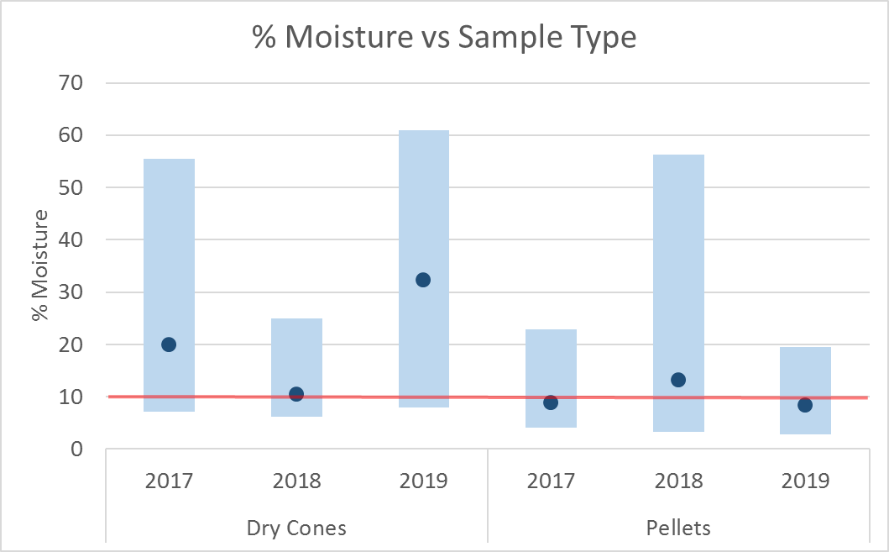
Moisture
2017 - 2019
Ideal is 10% (red line)
2019 Dry Cones
Only 6 samples, results slightly misleading
3 samples average 56%
3 samples average 8.5%
2019 Pellets
Good results
Overall, 2019 good moisture control
(Note: 2018 data updated to include samples received after 2018 report)
Notes:
Moisture results good this year – not that dry cones had few sample, and 3 samples skewed the results

Slide 5
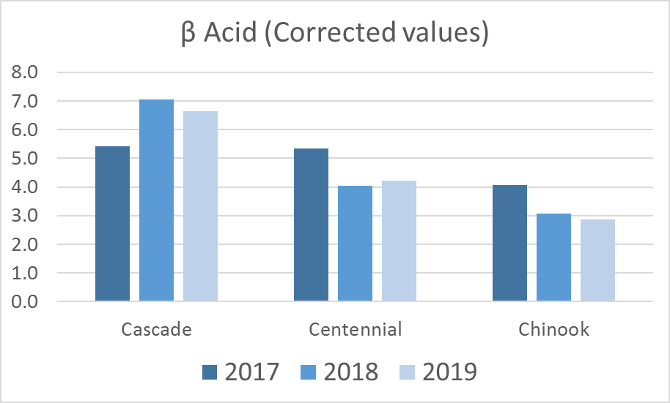
α and β Acids 2017-2019
2017 - 2019
Only 3 varietals had enough samples for a valid comparison
No significant differences in average values over 3 years
Expected ranges:
Cascade: 5.5-9.0/6.0-7.5
Centennial: 7.0-12.0/3.5-5.5
Chinook: 11.5-15.0/3.0-4.0
Notes:
Data for 3 varietals over 3 years – differences, but nothing significant and no trend based on growing season

Slide 6
For more information visit: ncinnovation.ca
Elizabeth Best: ebest@niagaracollege.ca
SOLUTIONS FOR INDUSTRY
Providing innovation solutions to business and industry through applied research in partnership with Niagara College faculty and students.

